Slide 1

QuerylessDB : AI-Driven Database Retrieval System
Presented by: Aayush Saraf - 22BIT0603
Guide: Dr. SWARNA PRIYA R.M
Department: SCORE

Slide 2



The Challenge: Bridging the Data-Knowledge Gap
Explosive Data Growth
Technical Access Barriers
Demand for Natural Interaction
Across e-commerce, healthcare, education, and more, structured data is accumulating at an unprecedented rate.
Accessing this valuable data typically demands specialized technical knowledge, such as SQL or MongoDB query languages.
There's a critical need for intuitive systems that enable users to query databases using everyday language.

Slide 3
The Problem: Inefficient Data Retrieval
Query Language Dependency
Decision-Making Bottlenecks
Rigid Systems
Existing interfaces often lack the adaptability to handle the nuances of natural language queries.
Users are forced to learn complex query languages, hindering direct access to information.
Reliance on developers or pre-built dashboards slows down critical decision-making processes.

Slide 4

Our Motivation: Empowering Data Access
Democratizing Data Access
To make data access truly intuitive and effortlessly easy for everyone, regardless of technical background.
Bridging the Human-Data Divide
To eliminate the barriers between human users and complex structured data sources.
Automating Query Generation
To harness the power of Artificial Intelligence and Natural Language Processing to automatically translate human intent into executable queries.

Slide 5
Project Objectives
1
2
Natural Language Querying
Intent & Parameter Recognition
Enable users to interact with structured databases using plain English sentences.
Automatically identify user intent and extract critical parameters from natural language input.
3
4
MongoDB Query Generation
Flexible Response Formats
Translate recognized intent and parameters into accurate and executable MongoDB queries.
Deliver query results in various user-friendly formats, including text, tables, and dynamic charts.

Slide 6

Scope of Our AI-Based Interface
Our system is designed to provide a flexible and powerful solution for data interaction:
Database Compatibility: Fully supports MongoDB databases, leveraging their flexible schema capabilities.
Multi-Domain Applicability: Proven utility across diverse sectors including e-commerce, healthcare, and education.
Scalability & Extensibility: Built as a scalable system, with clear pathways for future enhancements such as voice input and integration with SQL databases.

Slide 7
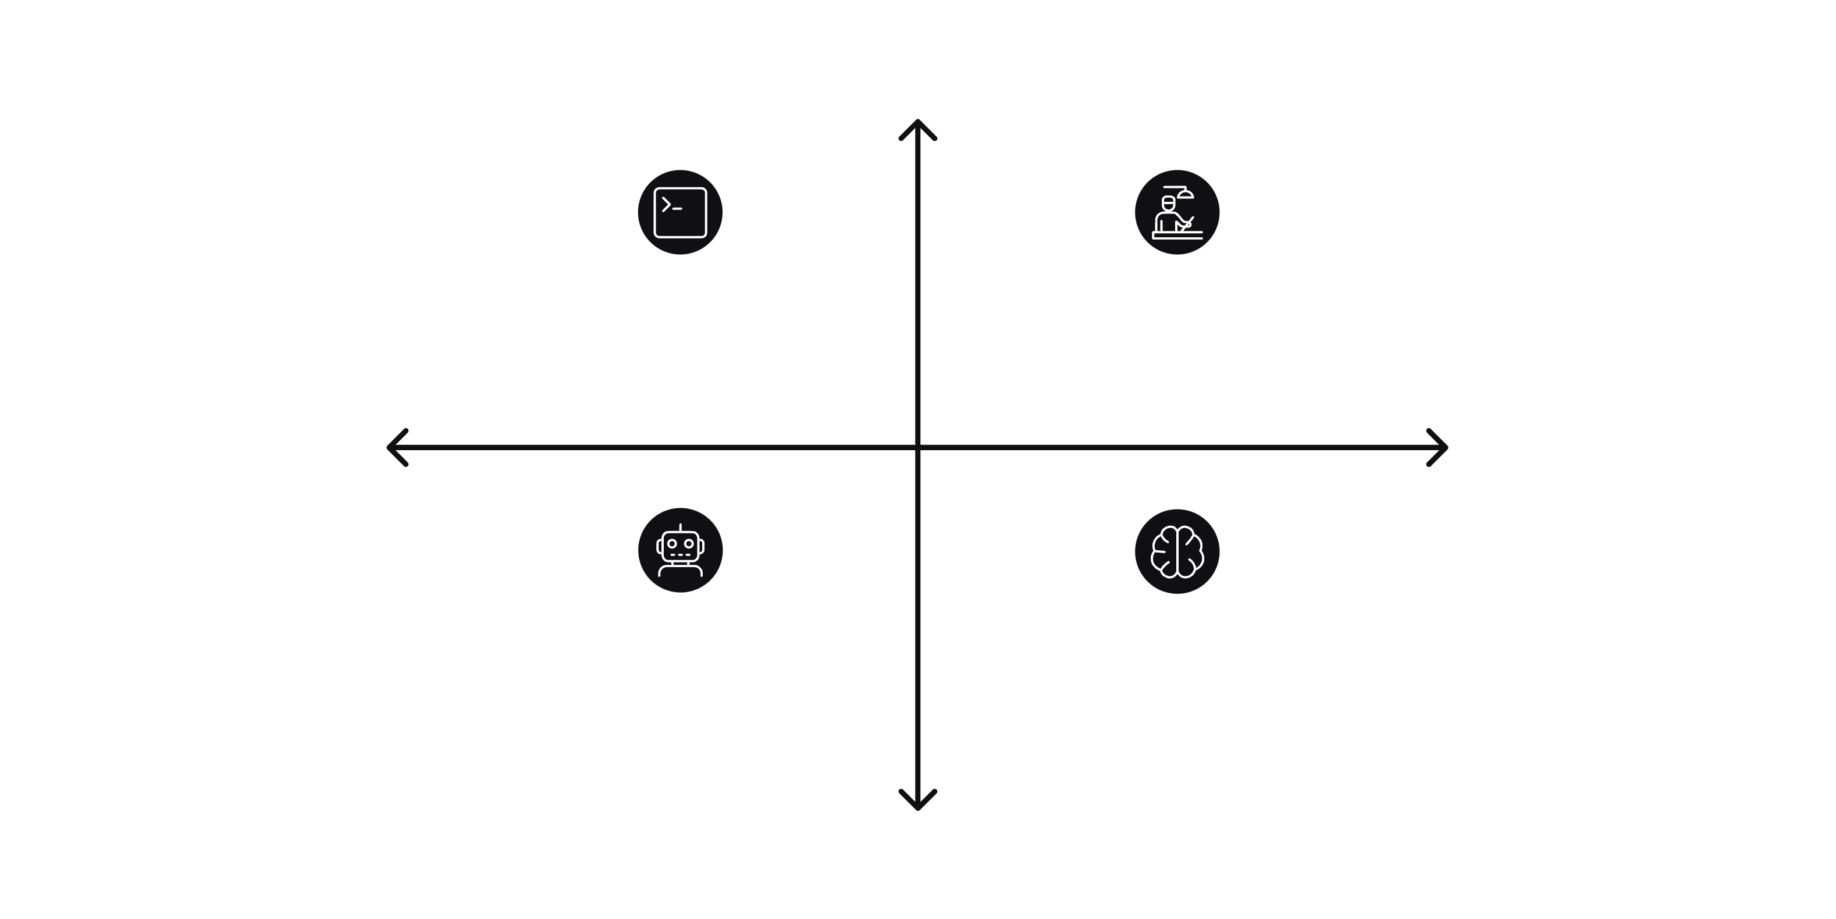




Evolution of Data Interaction
High Accuracy
Manual Querying — Requires technical SQL skills
Rule-Based NLP — Rigid rules, poor adaptability
Low Complexity
High Complexity
Chatbots — Natural language but no live DB access
AI-Integrated System — Adaptive, live data interaction
Low Accuracy
While various methods exist for data interaction, each presents distinct limitations that our AI-based system aims to overcome.

Slide 8
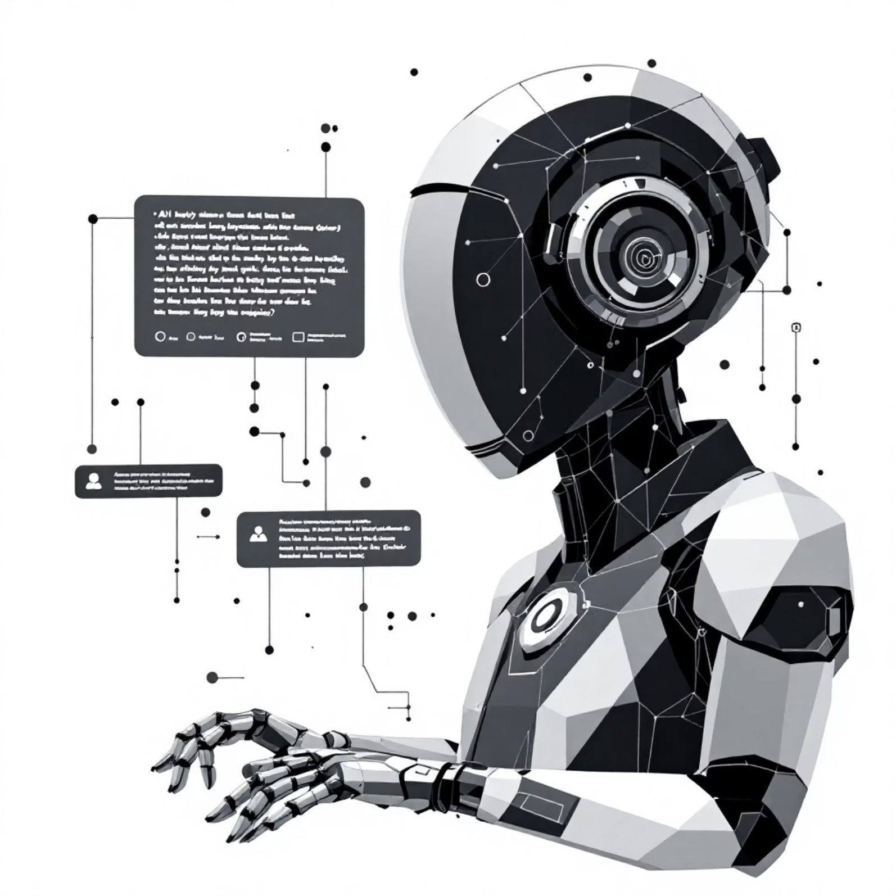
Proposed System: Dynamic AI-Driven Queries
AI-Powered: An intelligent system driven by advanced AI for natural language understanding.
Dynamic Conversion: Seamlessly transforms user's natural language queries into structured database queries in real-time.
Versatile Outputs: Presents results in a variety of intuitive formats, catering to different user needs.
Modular Architecture: Designed with a modular, scalable, and agent-based reasoning framework for robustness and flexibility.

Slide 9

System Architecture Overview
User Input
LLM / NLP
Agent Workflow
MongoDB Response
Our architecture orchestrates a smooth flow from user query to database response, with an optional frontend for enhanced visualization.

Slide 10
Our Core Technology Stack
Frontend (Optional): React
Backend: FastAPI
For building intuitive and responsive user interfaces.
A modern, fast (high-performance) web framework for building APIs with Python 3.7+.
Database: MongoDB
AI/NLP: LLMs, LangChain, LangGraph
A flexible, scalable NoSQL document database for efficient data storage.
Leveraging Large Language Models and advanced frameworks for natural language understanding and agent orchestration.
Programming Language: Python
Connectivity: REST APIs
The primary language for backend logic and AI development.
Ensuring seamless communication between different system components.

Slide 11
The Brains Behind the Queries: AI & LLMs
Understand Natural Language
Detect Intent & Entities
LLMs parse and interpret diverse user queries, capturing the full scope of intent and context.
Identify the core purpose of a query and extract key data points (entities) for precise execution.
Map to Database Operations
Handle Ambiguity & Phrasing
Translate understood intent and extracted entities into actionable database commands, e.g., SQL or NoSQL queries.
Navigate variations in user language, ensuring robust understanding even with imprecise or diverse phrasings.

Slide 12

Orchestrating Intelligence: LangChain & LangGraph
LangChain: The Foundation
LangGraph: Agentic Workflows
Manages the intricate chain of prompts, seamlessly integrates various tools, and ensures structured outputs for reliable data processing.
Enables sophisticated, multi-step reasoning through agent-based workflows, perfect for complex, dynamic interactions with databases.
Prompt engineering
Tool integration
Output parsing
Multi-step reasoning
Agent-based architecture
Dynamic execution
These frameworks are crucial for modularizing the system and achieving exceptional scalability and flexibility.

Slide 13

Seamless Interaction: The Query Workflow
User Query
FastAPI
LLM
LangChain
This streamlined process transforms natural language into actionable data insights and delivers them efficiently to the user.

Slide 14

Query in Action: A Practical Example
User Query
Generated MongoDB Query
"Show all orders above ₹5000 last week."
db.orders.find({
amount: { $gt: 5000 },
date: { $gte: lastWeekStart, $lte: lastWeekEnd }
})
The system translates human intent into precise database commands, delivering data in preferred formats like tables, charts, or summaries.

Slide 15
Unlocking Potential: Key Advantages
Technical Knowledge Not Required
Dynamic Query Generation
Democratizes data access, allowing non-technical users to query complex systems effortlessly.
Adapts to diverse phrasing and complex requests, generating accurate database queries on the fly.
Modular & Scalable Architecture
Multiple Output Formats
Built for growth, easily expandable to accommodate new features, data sources, and increased user demand.
Presents information in the most digestible way: tables, charts, or clear textual summaries, according to user preference.

Slide 16

Navigating Challenges: Current Limitations
Depends heavily on the accuracy and capabilities of the underlying LLM.
Highly complex or inherently ambiguous queries may still require user clarification.
Performance can be impacted by the size and complexity of the dataset being queried.
Advanced security features and granular user access controls are not yet fully implemented.

Slide 17




Impact Across Industries: Diverse Applications
E-commerce
Healthcare
Education
Business Analytics
Unlock insights into order analytics, sales trends, inventory management, and customer behavior.
Efficiently retrieve patient records, treatment data, research findings, and administrative information.
Monitor student performance, track academic progress, manage course data, and analyze learning outcomes.
Gain instant access to revenue reports, product insights, market analysis, and operational metrics.

Slide 18

Evolving Intelligence: Future Enhancements
01
Voice-Based Query Support
Integrate speech-to-text for an even more intuitive and hands-free user experience.
02
Multi-Database Support
Expand compatibility to include a wider range of databases, both SQL and NoSQL.
03
Personalized Query Suggestions
Leverage user history and context to proactively suggest relevant queries, enhancing efficiency.
04
Improved Query Optimization
Enhance the generated queries for better performance and implement advanced error handling mechanisms.

Slide 19

Conclusion: Bridging Language and Data
Bridged the Gap
Successfully connected natural language with structured data for accessible interaction.
Dynamic & Adaptive
AI and agent-based reasoning drive dynamic query generation for diverse needs.
User-Centric
Designed for user-friendliness, scalability, and adaptability across various domains.
Practical Integration
A real-world example of AI, databases, and web technologies working in harmony.

